Slide 1

ENVIRONMENT MONITORING SYSTEM
A PROJECT BASED ON IOT AND ML
BY SHASHANK KUMAR AND PRANJUL MITTAL

Slide 2
Prediction using Node mcu
Will it rain or we will again stuck with our disappointment that the match got dismissed.
How can you determine that this condition is okay for the cricket match or not.
Even after all the modern equipment we can predict these thing with ease with this device.

Slide 3
Components used in this project
Node mcu (esp8266)
DHT sensor
LDR sensor
LED
Connecting Wires

Slide 4
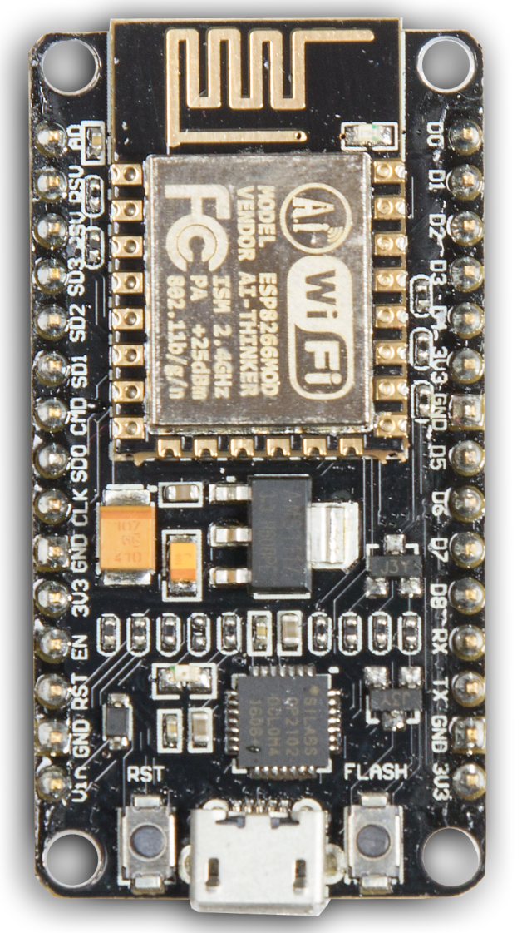
NODE MCU
Features
Programable WiFi module.
Arduino-like (software defined) hardware IO.
Can be programmed with the simple and powerful Lua programming language or Arduino IDE.
USB-TTL included, plug & play.
10 GPIOs D0-D10, PWM functionality, IIC and SPI communication, 1-Wire and ADC A0 etc. all in one board.
Wifi networking (can be used as access point and/or station, host a web server), connect to internet to fetch or upload data.
Event-driven API for network applications.
PCB antenna.

Slide 5
MACHINE LEARNING AND SERIAL COM
The main part of this project depends on machine learning and serial communication .Arduino takes values using nodemcu (temperature,humidity,light density) and then the values have transfer to the jupyter notebook (python) .Using machine learning we are training the data and then prediction has been done for that particular value by blinking the led connecting to bread board.

Slide 6
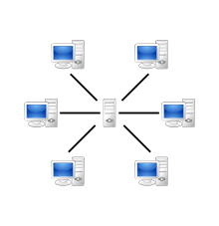
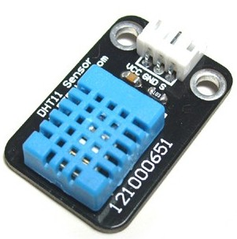

WORKING DIAGRAM
SERVER
SENSORS
NODE MCU

